Slide 1
CS 590 Algorithm
Chapter 6 Hash Tables
Source: Goodrich, M. T., & Tamassia, R. (2015). Algorithm Design and Applications. Hoboken, NJ: Wiley.

Slide 2
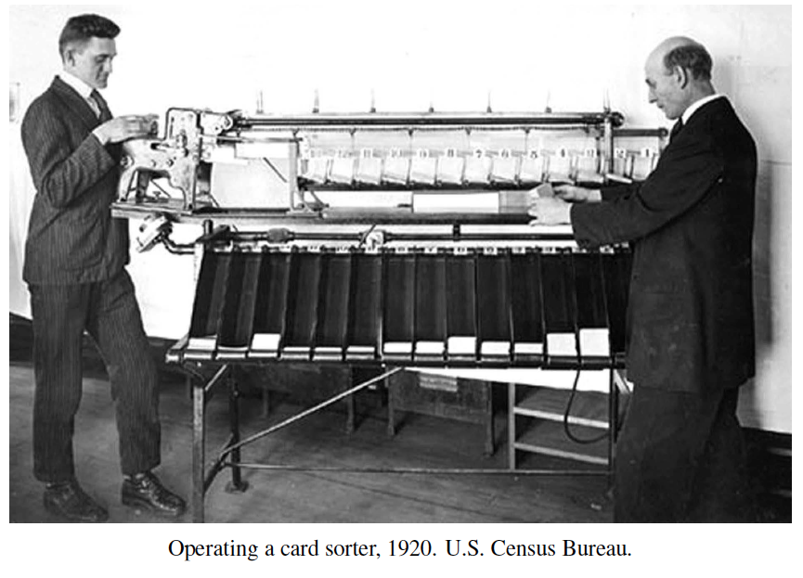
Hash Tables
Presentation for use with the textbook Algorithm Design and Applications, by M. T. Goodrich and R. Tamassia, Wiley, 2015

Slide 3
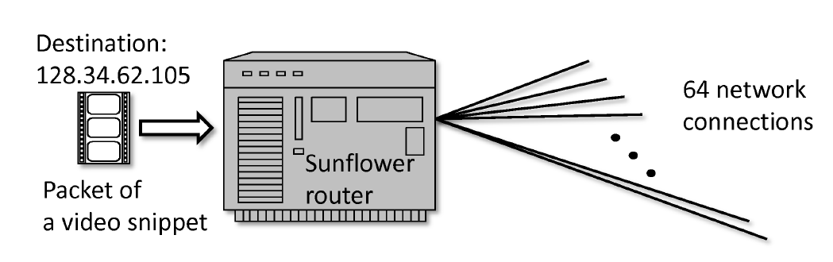
Application: Network Routers
Network routers process multiple streams of information packets at high speed.
To process a packet, (k,x), where k is a key for the destination and x is the data payload, a router must very quickly determine which of its network connections to send this packet.
Such a system needs to support key-based lookups, i.e., get(k) operations, as well as put(k,c) updates to add a new connection, c, for a destination key, k.
Ideally, we would like to achieve O(1) time performance for both get and put operations.

Slide 4
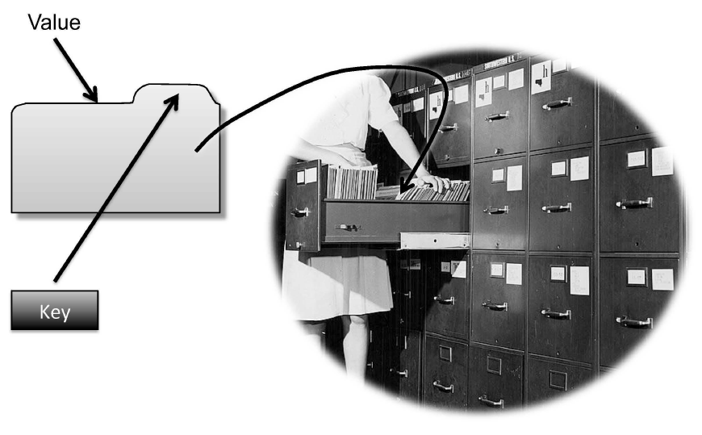
Maps
A map (or dictionary) models a searchable collection of key-value entries (k, v) we call items
The main operations of a map are for searching, inserting, and deleting items
Multiple entries with the same key are not allowed
Other Applications:
address book
student-record database

Slide 5
Map Operations
get(k): if the map M has an entry with key k, return its associated value; else, return null
put(k, v): insert item (k, v) into the map M;
if key k is already in M, then replace its value with v.
remove(k): if the map M has an entry with key k, remove it from M and return its associated value; else, return null
size(), isEmpty()

Slide 6
Example
Operation Output Map
isEmpty() true Ø
put(5,A) null (5,A)
put(7,B) null (5,A),(7,B)
put(2,C) null (5,A),(7,B),(2,C)
put(8,D) null (5,A),(7,B),(2,C),(8,D)
put(2,E) C (5,A),(7,B),(2,E),(8,D)
get(7) B (5,A),(7,B),(2,E),(8,D)
get(4) null (5,A),(7,B),(2,E),(8,D)
get(2) E (5,A),(7,B),(2,E),(8,D)
size() 4 (5,A),(7,B),(2,E),(8,D)
remove(5) A (7,B),(2,E),(8,D)
remove(2) E (7,B),(8,D)
get(2) null (7,B),(8,D)
isEmpty() false (7,B),(8,D)

Slide 7
A Simple List-Based Map
We can implement a map using an unsorted list
We store the items of the map in a list S (based on a doubly-linked list), in arbitrary order
header
nodes/positions
trailer
9
c
6
c
5
c
8
c
entries

Slide 8
Performance of a List-Based Map
Performance:
put takes O(1) time since we can insert the new item at the beginning or at the end of the sequence
get and remove take O(n) time since in the worst case (the item is not found) we traverse the entire sequence to look for an item with the given key
The unsorted list implementation is effective only for maps of small size or for maps in which puts are the most common operations, while searches and removals are rarely performed (e.g., historical record of logins to a workstation)

Slide 9
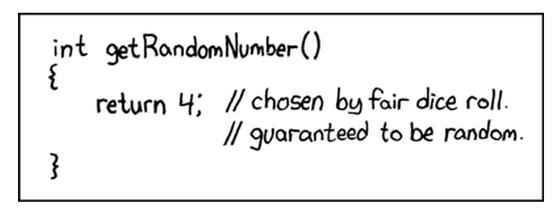
Lookup Tables
Presentation for use with the textbook Algorithm Design and Applications, by M. T. Goodrich and R. Tamassia, Wiley, 2015
xkcd. http://xkcd.com/221/. “Random Number.” Used with permission under Creative Commons 2.5 License.

Slide 10

Recall the Map Operations
get(k): if the map M has an entry with key k, return its associated value; else, return null
put(k, v): insert entry (k, v) into the map M; if key k is already in M, replace its value with v.
remove(k): if the map M has an entry with key k, remove it from M and return its associated value; else, return null
size(), isEmpty()

Slide 11
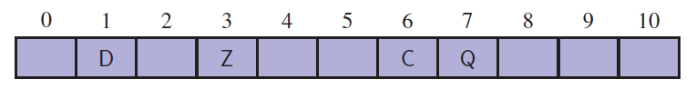
Lookup Tables
Intuitively, a map M supports the abstraction of using keys as indices with a syntax such as M[k].
Lookup table is an implementation of a Map in a restricted setting in which a map with n items uses keys that are known to be integers in a range from 0 to N − 1, for some N ≥ n.
Lookup table map methods (put, get, and remove) run in O(1) when its implemented as an array.

Slide 12
More General Kinds of Keys
But what should we do if our integer keys are not in the range from 0 to N – 1 and we want a lookup table?
Use a hash function to map general keys to corresponding indices in a table.
For instance, the last four digits of a Social Security number.
0
∅
1
025-612-0001
2
981-101-0002
3
∅
4
451-229-0004
…

Slide 13
Hash Functions and Hash Tables
A hash function h maps keys of a given type to integers in a fixed interval [0, N − 1]
Example: h(x) = x mod N is a hash function for integer keys
The integer h(x) is called the hash value of key x
A hash table for a given key type consists of
Hash function h
Array (called table) of size N
When implementing a map with a hash table, the goal is to store item (k, v) at index i = h(k)

Slide 14
Example
We design a hash table for a map storing entries as (SSN, Name), where SSN (social security number) is a nine-digit positive integer
Our hash table uses an array of size N = 10,000 and the hash function h(x) = last four digits of x
0
∅
1
025-612-0001
2
981-101-0002
3
∅
4
451-229-0004
…
9997
∅
9998
200-751-9998
9999
∅

Slide 15
Hash Functions
A hash function is usually specified as the composition of two functions:
Hash code: h₁: keys → integers
Compression function: h₂: integers → [0, N − 1]
The hash code is applied first, and the compression function is applied next on the result, i.e., h(x) = h₂(h₁(x))
The goal of the hash function is to “disperse” the keys in an apparently random way

Slide 16
Hash Codes
We can assume any key is a binary string.
Memory address:
We reinterpret the memory address of the key object as an integer. Good in general, except for string, where we can view them as tuples
Integer cast:
We reinterpret the bits of the key as an integer
Suitable for keys of length less than or equal to the number of bits of the integer type (e.g., byte, short, int and float)
Component sum:
We partition the bits of the key into components of fixed length (e.g., 16 or 32 bits) and we sum the components (ignoring overflows) or XOR the components
Suitable for numeric keys of fixed length greater than or equal to the number of bits of the integer type.

Slide 17
Hash Codes (cont.)
Polynomial accumulation:
We partition the bits of the key into a sequence of components of fixed length (e.g., 8, 16 or 32 bits) a₀ a₁ … a_{n−1}
We evaluate the polynomial
p(z) = a₀ + a₁ z + a₂ z² + … … + a_{n−1}z^{n−1}
at a fixed value z, ignoring overflows
Especially suitable for strings (e.g., the choice z = 33 gives at most 6 collisions on a set of 50,000 English words)
Polynomial p(z) can be evaluated in O(n) time using Horner’s rule:
The following polynomials are successively computed, each from the previous one in O(1) time
p₀(z) = a_{n−1}
p_{i} (z) = a_{n−i−1} + zp_{i−1}(z) (i = 1, 2, …, n −1)
So p(z) = a₀ ₊zp_{n−1}(z)

Slide 18
Tabulation-Based Hashing
Suppose each key can be viewed as a tuple, k = (x₁, x₂, . . . , x_{d}), for a fixed d, where each x_{i} is in the range [0,M − 1].
There is a class of hash functions we can use, which involve simple table lookups, known as tabulation-based hashing.
We can initialize d tables, T₁, T₂, . . . , T_{d}, of size M each, so that each T_{i}[j] is a uniformly chosen independent random number in the range [0,N − 1].
We then can compute the hash function, h(k), as
h(k) = T₁[x₁] ⊕ T₂[x₂] ⊕ . . . ⊕ T_{d}[x_{d}],
where “⊕” denotes the bitwise exclusive-or function.
Because the values in the tables are themselves chosen at random, such a function is itself fairly random. For instance, it can be shown that such a function will cause two distinct keys to collide at the same hash value with probability 1/N, which is what we would get from a perfectly random function.

Slide 19
Compression Functions
Division:
h₂ (y) = y mod N
The size N of the hash table is usually chosen to be a prime
The reason has to do with number theory and is beyond the scope of this course
Random linear hash function:
h₂ (y) = (ay + b) mod N
a and b are random nonnegative integers such that a mod N ≠ 0
Otherwise, every integer would map to the same value b

Slide 20
Collision Handling
Collisions occur when different elements are mapped to the same cell
Separate Chaining: let each cell in the table point to a linked list of entries that map there
0
∅
1
025-612-0001
2
∅
3
∅
4
451-229-0004
981-101-0004
Separate chaining is simple, but requires an auxiliary data structure (the linked list) outside the table

Slide 21
Map with Separate Chaining
Delegate operations to a list-based map at each cell:
Algorithm get(k):
If A[h(k)] =NULL then
return NULL
else
return A[h(k)].get(k) {Do a lookup in the list}
Algorithm put(k,v):
If A[h(k)]=NULL then
create a new initially empty linked list B at A[h(k)]
return A[h(k)].put(k)
Algorithm remove(k):
If A[h(k)] =NULL
return NULL
else
return A[h(k)].remove(k)

Slide 22
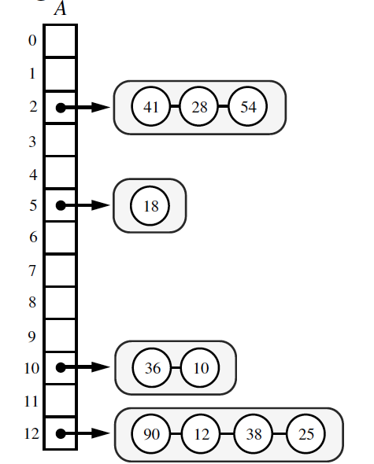
Performance of Separate Chaining
Let us assume that our hash function, h, maps keys to independent uniform random values in the range [0,N−1].
Thus, if we let X be a random variable representing the number of items that map to a bucket, i, in the array A, then the expected value of X, E(X) = n/N, where n is the number of items in the map, since each of the N locations in A is equally likely for each item to be placed.
This parameter, n/N, which is the ratio of the number of items in a hash table, n, and the capacity of the table, N, is called the load factor of the hash table.
If it is O(1), then the above analysis says that the expected time for hash table operations is O(1) when collisions are handled with separate chaining.

Slide 23
Linear Probing
Open Addressing Method: the colliding item is placed in a different cell of the table. There are several ways:
Linear probing: is an Open Addressing that handles collisions by placing the colliding item in the next (circularly) available table cell
Each table cell inspected is referred to as a “probe”
Colliding items lump together, causing future collisions to cause a longer sequence of probes
Example:
h(x) = x mod 13
Insert keys 18, 41, 22, 44, 59, 32, 31, 73, in this order
0
1
2
3
4
5
6
7
8
9
10
11
12
41
18
44
59
32
22
31
73
0
1
2
3
4
5
6
7
8
9
10
11
12

Slide 24
Search with Linear Probing
Consider a hash table A that uses linear probing
get(k)
We start at cell h(k)
We probe consecutive locations until one of the following occurs
An item with key k is found, or
An empty cell is found, or
N cells have been unsuccessfully probed
Algorithm get(k)
i ← h(k)
p ← 0
repeat
c ← A[i]
if c = ∅
return null
else if c.getKey () = k
return c.getValue()
else
i ← (i + 1) mod N
p ← p + 1
until p = N
return null

Slide 25
Updates with Linear Probing
To handle deletions, we introduce a special object, called Deactivated, which replaces deleted elements. An alternative is to shift elements to fill the “hole”
remove(k)
We search for an entry with key k
If such an entry, (k, v), is found, we move elements to fill the “hole” created by its removal.
put(k, v)
We throw an exception if the table is full
We start at cell h(k)
We probe consecutive cells until a cell i is found that is empty.
We store (k, v) in cell i

Slide 26
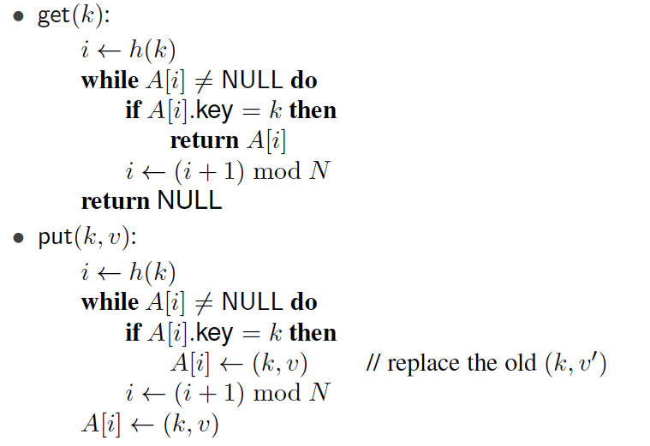
Pseudo-code for get and put

Slide 27
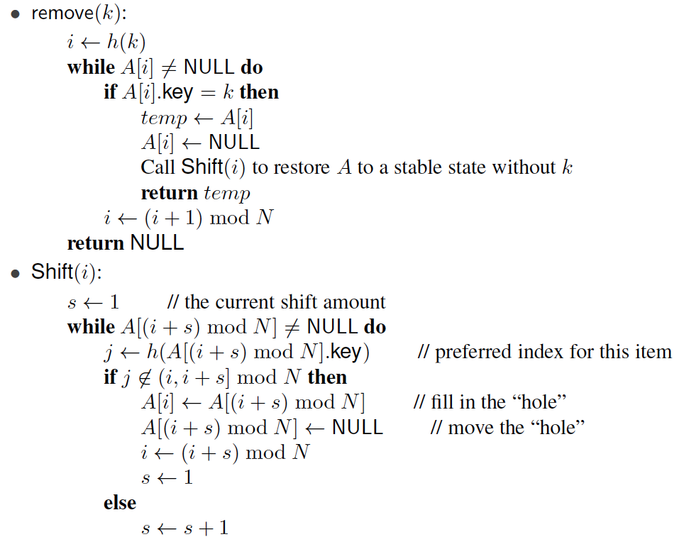
Pseudo-code for remove

Slide 28
Performance of Linear Probing
In the worst case, searches, insertions and removals on a hash table take O(n) time
The worst case occurs when all the keys inserted into the map collide
The load factor α = n/N affects the performance of a hash table
Assuming that the hash values are like random numbers, it can be shown that the expected number of probes for an insertion with open addressing is 1 / (1 − α)
The expected running time of all the dictionary ADT operations in a hash table is O(1) with constant load factor < 1
In practice, hashing is very fast provided the load factor is not close to 1
Applications of hash tables:
small databases
compilers
browser caches

Slide 29
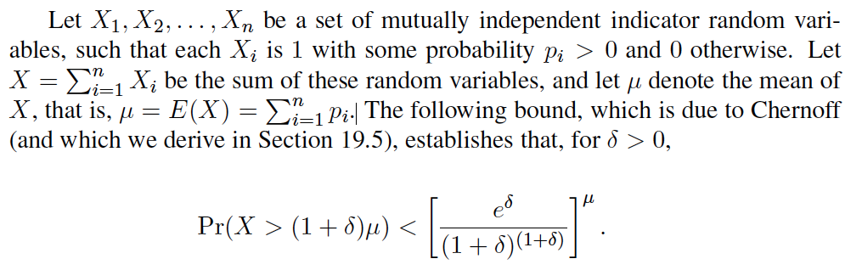
A More Careful Analysis of Linear Probing
Recall that, in the linear-probing scheme for handling collisions, whenever an insertion at a cell i would cause a collision, then we instead insert the new item in the first cell of i+1, i+2, and so on, until we find an empty cell.
For this analysis, let us assume that we are storing n items in a hash table of size N = 2n, that is, our hash table has a load factor of 1/2.

Slide 30
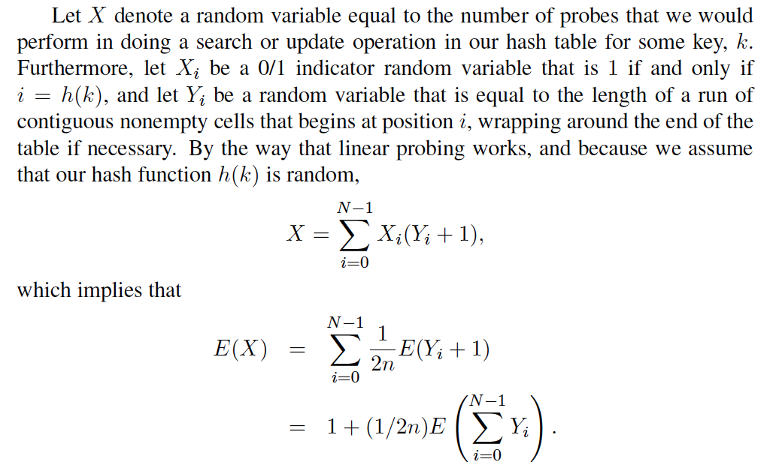
A More Careful Analysis of Linear Probing, 2
Thus, if we can bound the expected value of the sum of Y_{i}’s, then we can bound the expected time for a search or update operation in a linear-probing hashing scheme.

Slide 31
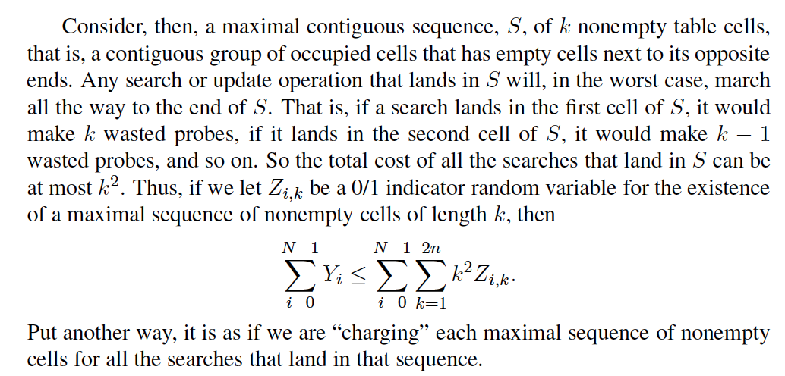
A More Careful Analysis of Linear Probing, 3

Slide 32
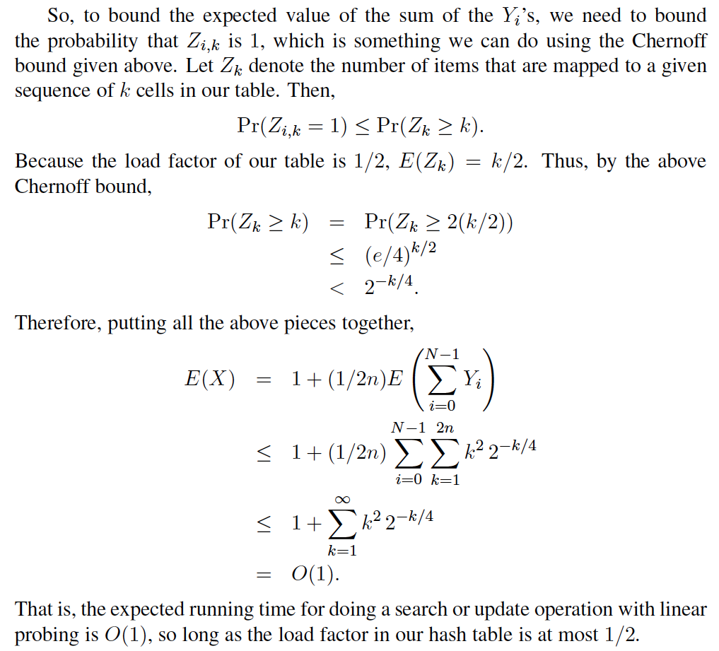
A More Careful Analysis of Linear Probing, 4

Slide 33
Double Hashing
Double hashing uses a secondary hash function d(k) that handles h(k)=i collision by placing the item in the first available cell of the series (i + jd(k)) mod N for j = 0, 1, … , N − 1
The secondary hash function d(k) cannot have zero values
The table size N must be a prime to allow probing of all the cells
Common choice of compression function for the secondary hash function:
d₂(k) = q − k mod q
where
q < N
q is a prime
The possible values for d₂(k) are 1, 2, … , q
The expected running time for a search is O(1). See Exercise C-6.3

Slide 34
Example of Double Hashing
Consider a hash table storing integer keys that handles collision with double hashing
N = 13
h(k) = k mod 13
d(k) = 7 − k mod 7
Insert keys 18, 41, 22, 44, 59, 32, 31, 73, in this order
0
1
2
3
4
5
6
7
8
9
10
11
12
31
41
18
32
59
73
22
44
0
1
2
3
4
5
6
7
8
9
10
11
12

Slide 35
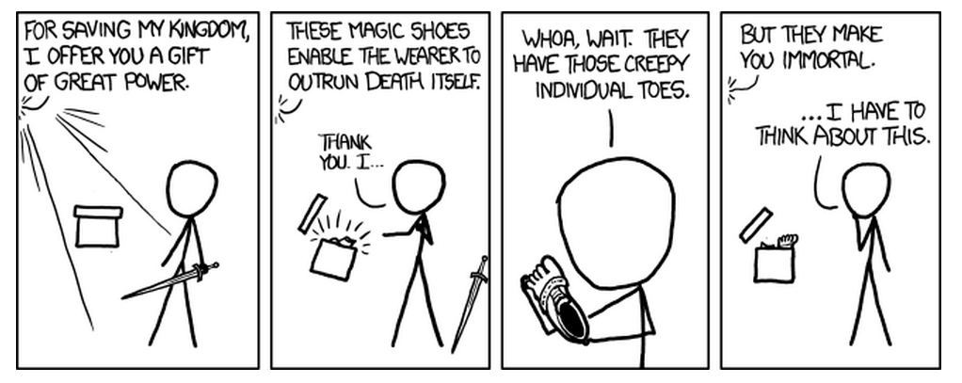
Cuckoo Hashing
Presentation for use with the textbook Algorithm Design and Applications, by M. T. Goodrich and R. Tamassia, Wiley, 2015
xkcd. http://xkcd.com/1065/. “Shoes.” Used with permission under Creative Commons 2.5 License.

Slide 36
The Power of Two Choices
In the cuckoo hashing scheme, we use two lookup tables, T₀ and T₁, each of size N, where N is greater than n, the number of items in the map, by at least a constant factor, say, N ≥ 2n.
We use a hash function, h₀, for T₀, and a different hash function, h₁, for T₁.
For any key, k, there are only two possible places where we are allowed to store an item with key k, namely, either in T₀[h₀(k)] or T₁[h₁(k)].
This freedom turns out to allow us to achieve O(1) worst-case running time for table lookups.

Slide 37
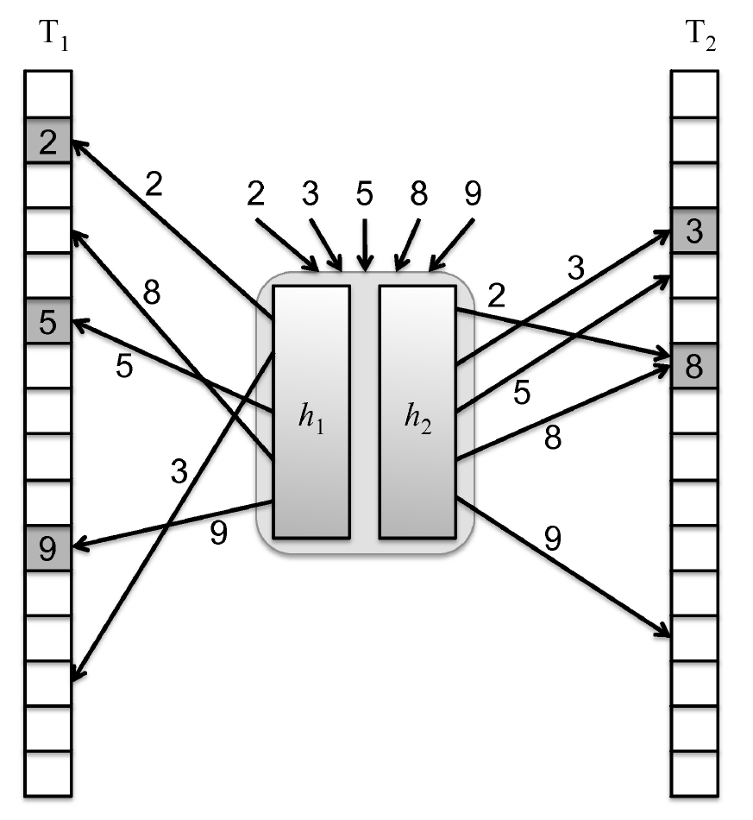
An Example of Cuckoo Hashing
Each of the keys in the set S = {2, 3, 5, 8, 9} has two possible locations it can go, one in the table T₁ and one in the table T₂.
Note that there is a collision of 2 and 8 in T₂, but that is okay, since there is no collision for 2 in its alternative location, in T₁.

Slide 38
Recall the Map Operations
get(k): if the map M has an entry with key k, return its associated value; else, return null
put(k, v): insert entry (k, v) into the map M; if key k is already in M, then replace its value with v.
remove(k): if the map M has an entry with key k, remove it from M and return its associated value; else, return null
size(), isEmpty()

Slide 39
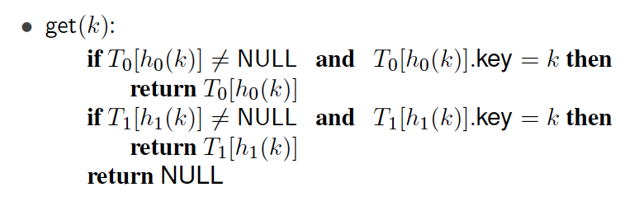
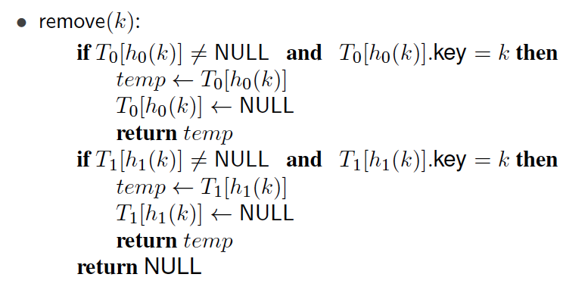
Pseudo-code for get and remove
The algorithms for get and remove are simple and run in O(1) time in the worst case.

Slide 40
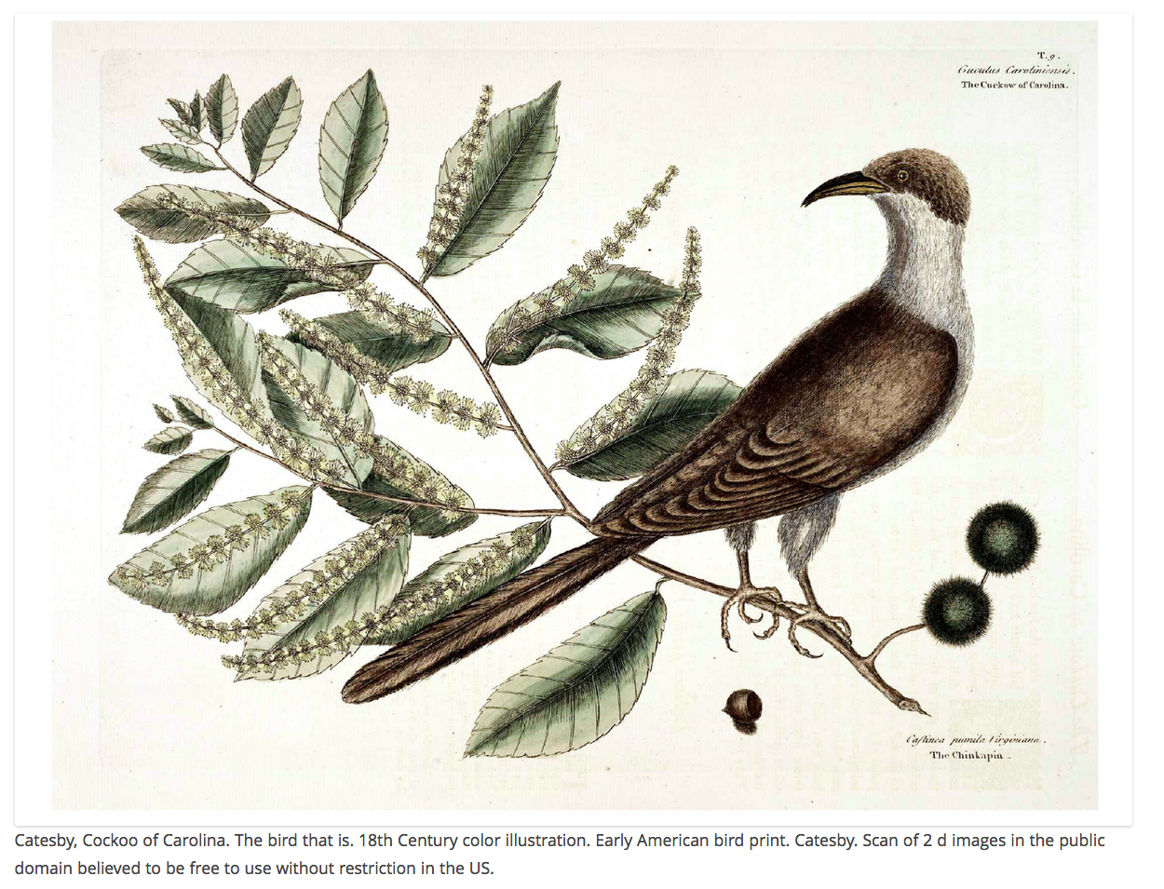
Intuition for the Name
The name “cuckoo hashing” comes from the way the put(k, v) operation is performed in this scheme, because it mimics the breeding habits of the Common Cuckoo bird.
The Common Cuckoo is a brood parasite—it lays its egg in the nest of another bird after first evicting an egg out of that nest.

Slide 41
Intuition for the Name - put
Similarly, if a collision occurs in the insertion operation in the cuckoo hashing scheme, then we evict the previous item in that cell and insert the new one in its place.
This forces the evicted item to go to its alternate location in the other table and be inserted there, which may repeat the eviction process with another item, and so on.
Eventually, we either find an empty cell and stop or we repeat a previous eviction, which indicates an eviction cycle.
If we discover an eviction cycle, then we stop the insertion process and rehash all the items in the two tables using new, hopefully better, hash functions.

Slide 42
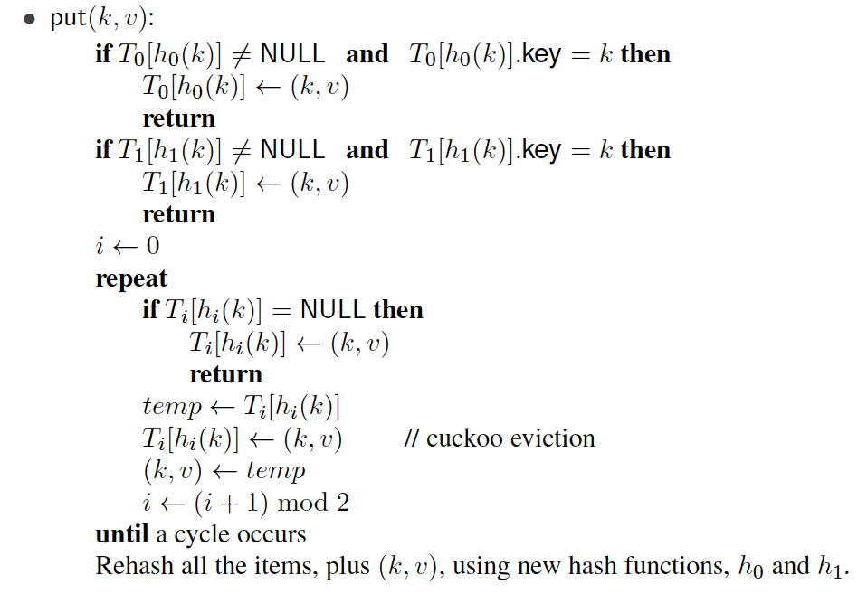
Pseudo-code for put
Note that the above pseudo-code has a condition for detecting a cycle in the sequence of insertions. There are several ways to formulate this condition. For example, we could count the number of iterations for this loop and consider there to be a cycle if we go over a certain threshold, like n or log n.

Slide 43
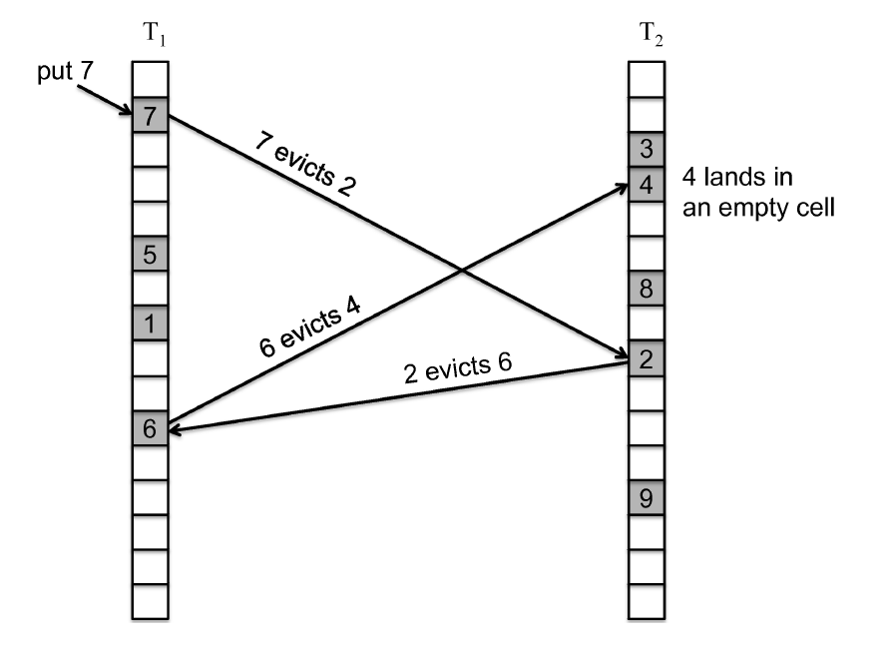
Example Eviction Sequence
An eviction sequence of length 3:

Slide 44
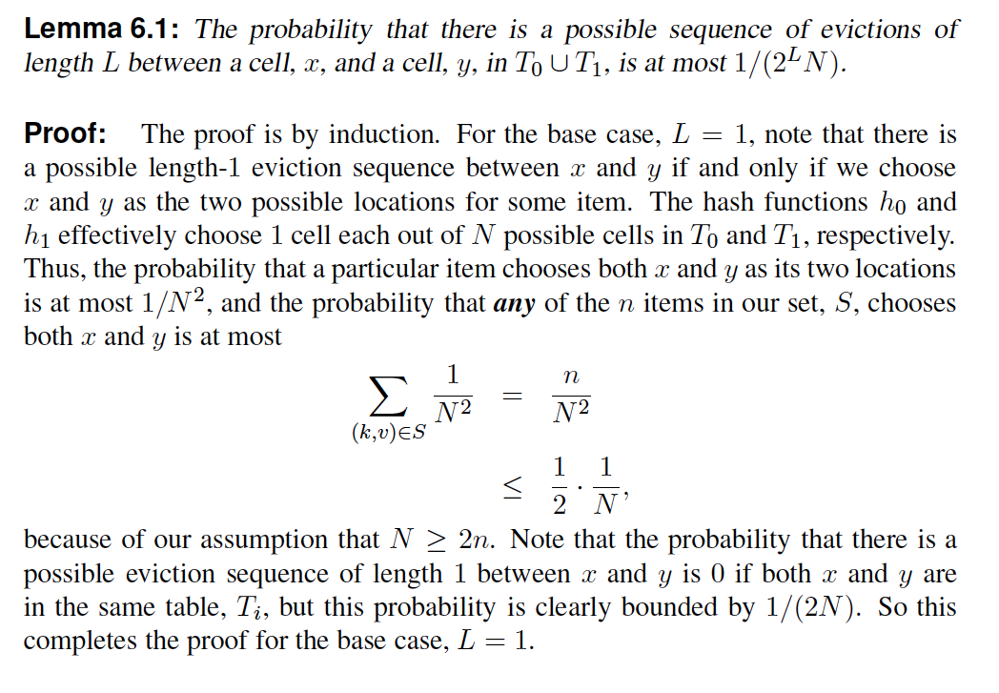
Long Eviction Sequences are Rare

Slide 45
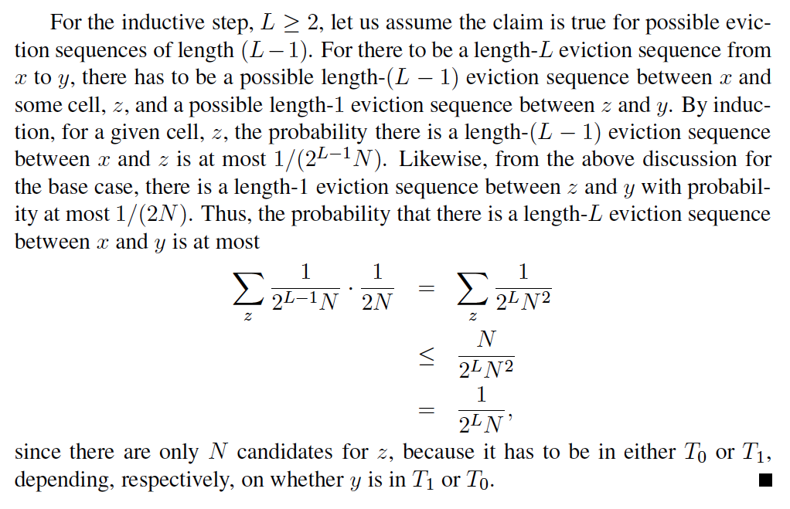
Long Eviction Sequences are Rare

Slide 46
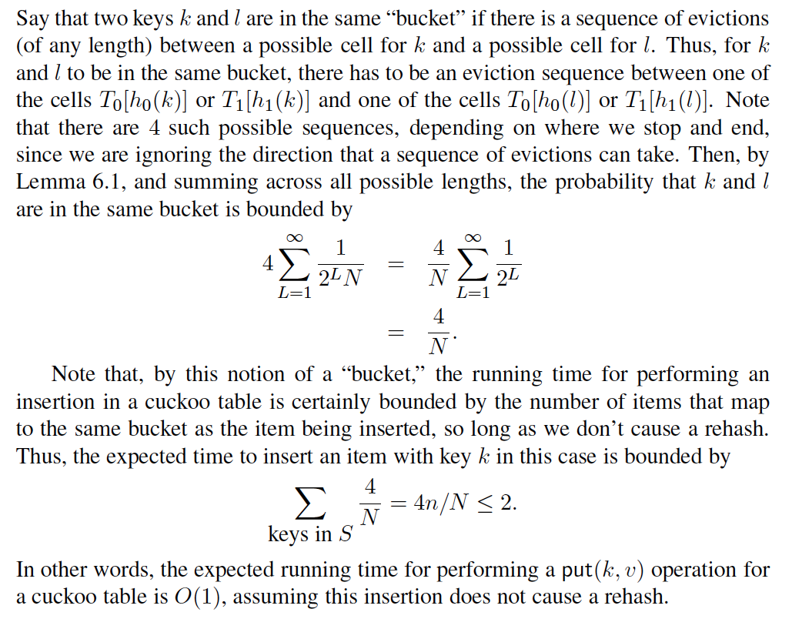
What is the Expected Number of Evictions?

Slide 47
Performance of Cuckoo Hashing
We can also show that, since long eviction sequences are rare, we will have to rehash only with very low probability.
Thus, the expected amortized time to perform any single insertion in a cuckoo table is O(1).
So a cuckoo hash table achieves worst-case O(1) time for lookups and removals, and expected O(1) time for insertions.
This performance is primarily because there are exactly two possible places for any item to be in a cuckoo hash table, which shows the power of two choices.

Slide 48
Universal Hashing
We can view a hash function h as a mapping from integers in the range [0, M − 1] to integers in the range [0, N − 1].
We can view the set of candidate hash functions we are considering as a family H of hash functions.
Such a family is universal if for any two integers j and k in the range [0, M − 1] and for a hash function chosen uniformly at random from H ,
Pr(h(j) = h(k)) ≤ 1/N
Such a family is also known as a 2-universal family of hash functions.

Slide 49
Universal Hashing
Define H as the set of hash functions of the form
h_{a,b}(k) = (ak + b mod p) mod N.
Theorem 6.3 establishes that this family of hash functions is universal for
0<a<p and 0≤b<p
Where p is a prime number greater than or equal to the number of hash codes M but less than 2M

Slide 50
About Stevens
A premier, private research university with a mission to inspire, nurture and educate leaders in tomorrow’s technology-centric environment while contributing to the solution of the most challenging problems of our time

